Slide 1

The Evil Garden
Theodosis Koulas & Vasiliki Minou

Slide 2

About our garden
At Evil Garden, we provide our customers with a variety of plants, vegetables and fruit. The application was created in order to facilitate the customers’ orders and navigation process through our careful selection of products.

Slide 3

Application overview
We created 4 dictionaries with the following data in each one.
1. Categories = {Category ID, Name, Description} 2. Products = {Product ID, Name, Price, Category ID} 3. Customer = {Customer ID, Email, Phone Number, Address, Location, Country} 4. Orders = {Order Id, Product Id, Quantity, Total cost, Customer Id, Status}
We then created an application that allows an admin to add new data as well as to view specific or all data.

Slide 4
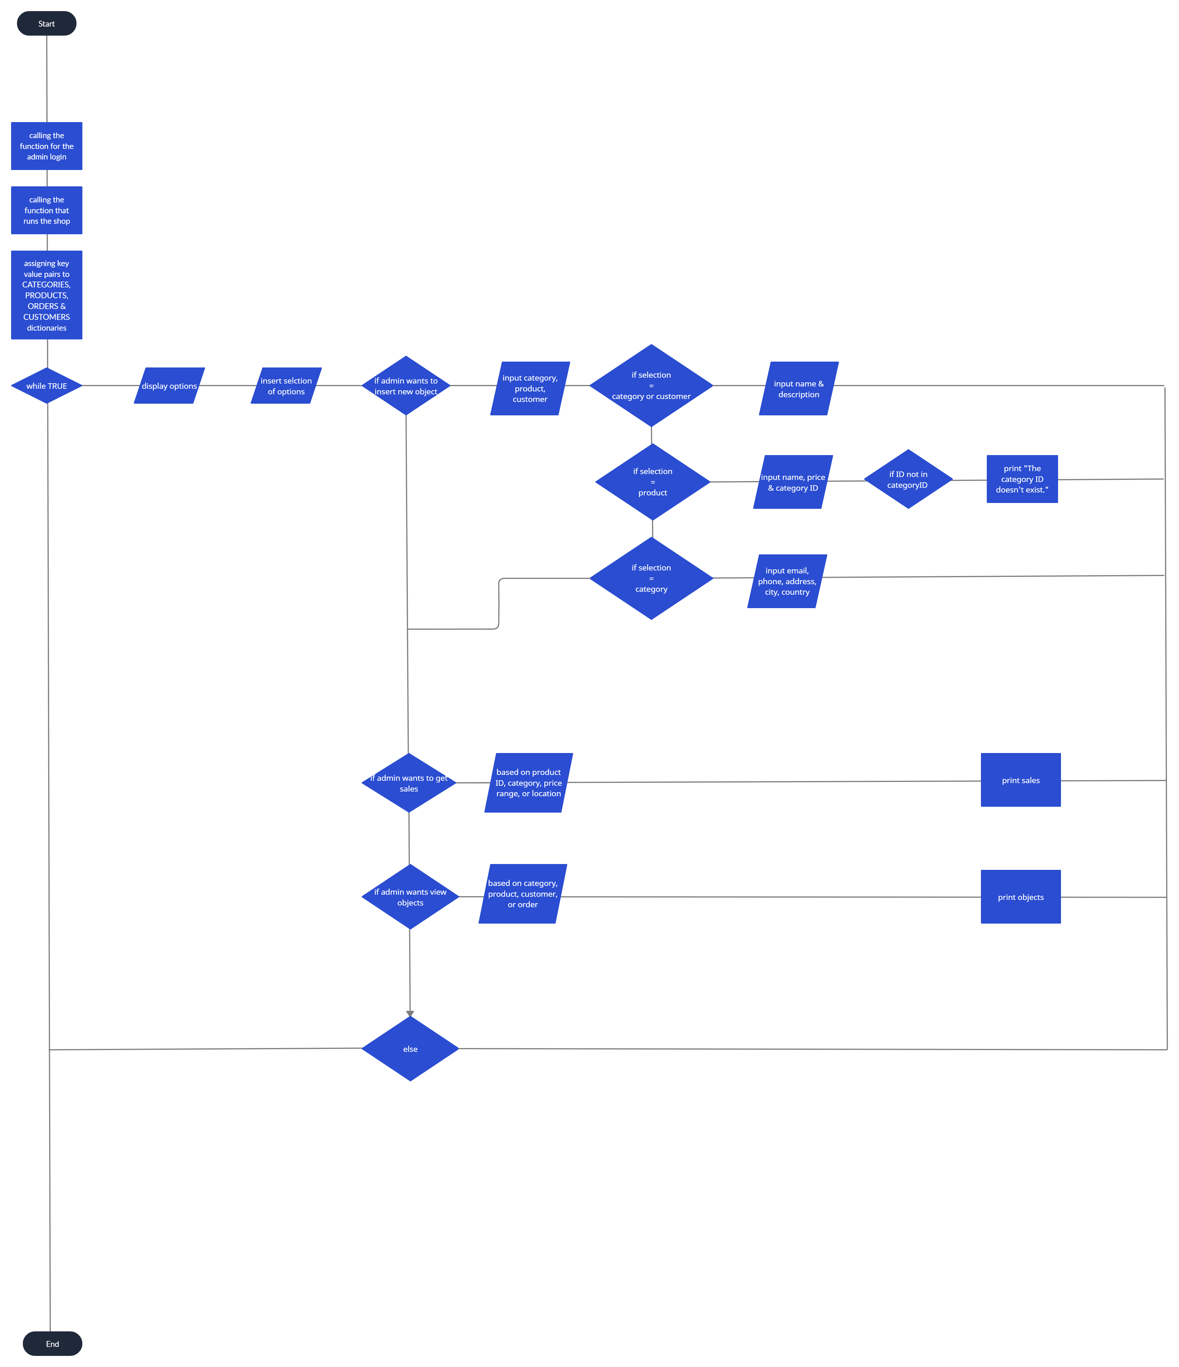
Flowchart

Slide 5
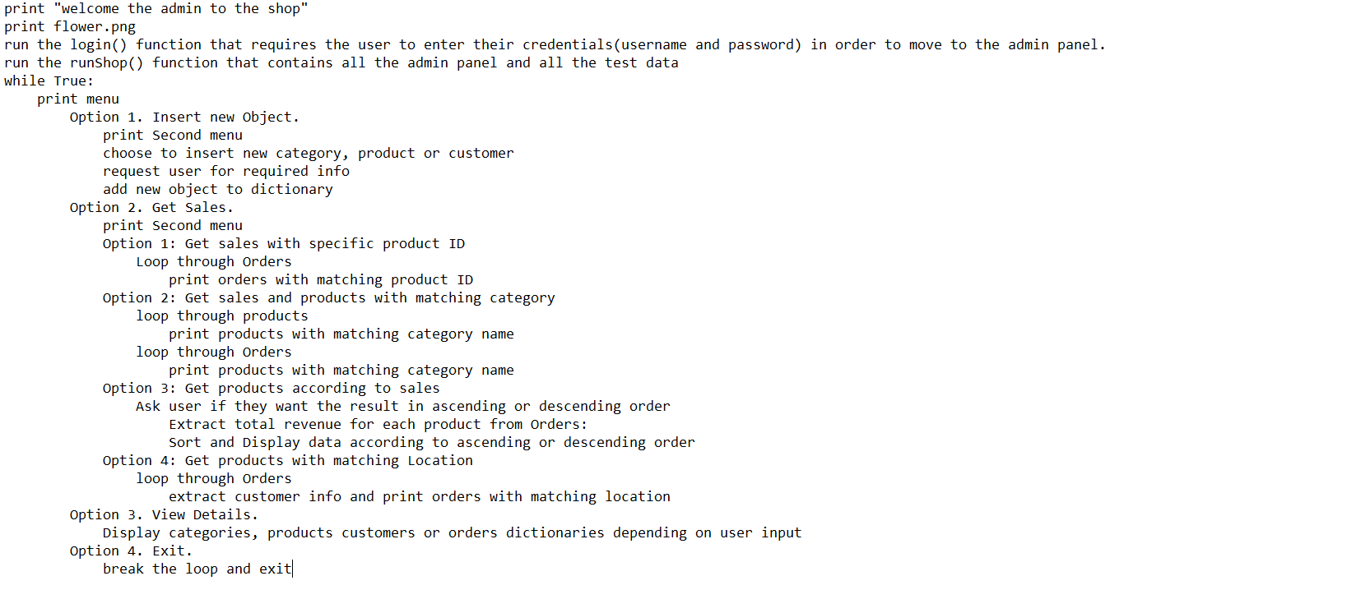
Pseudocode

Slide 6
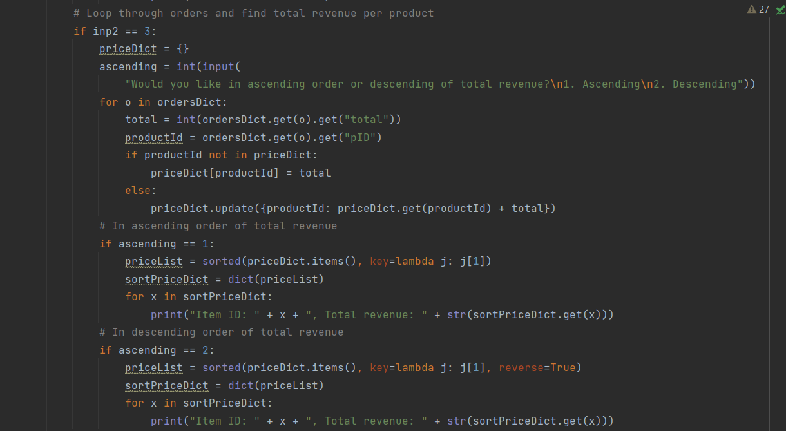
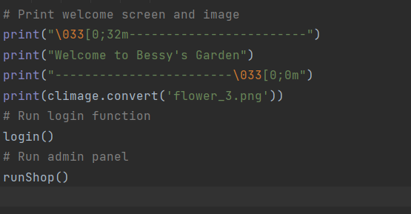
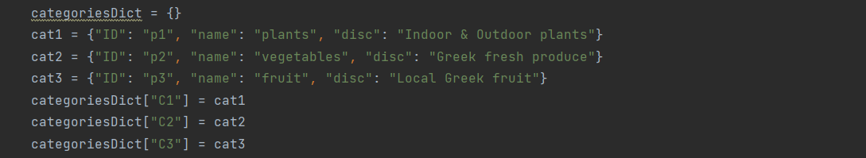

Slide 7
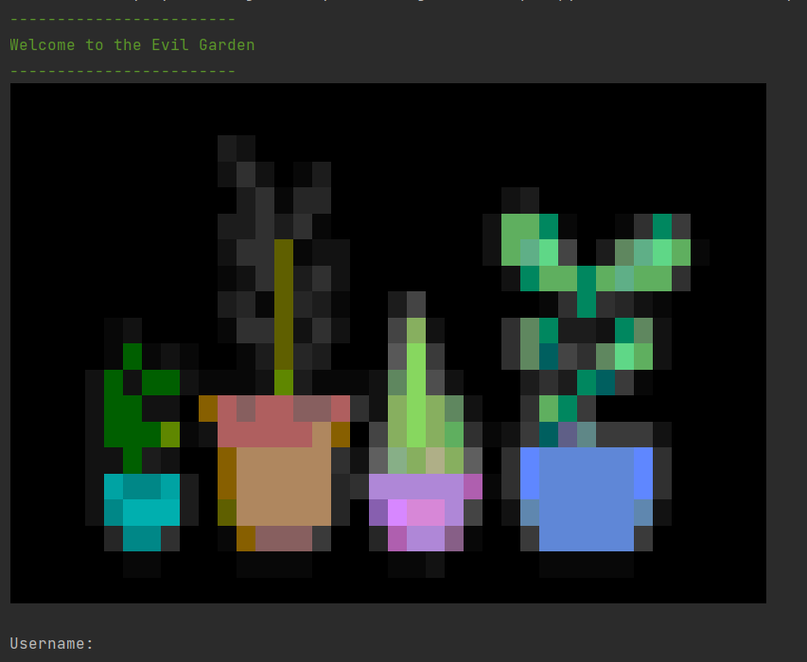
Outputs

Slide 8
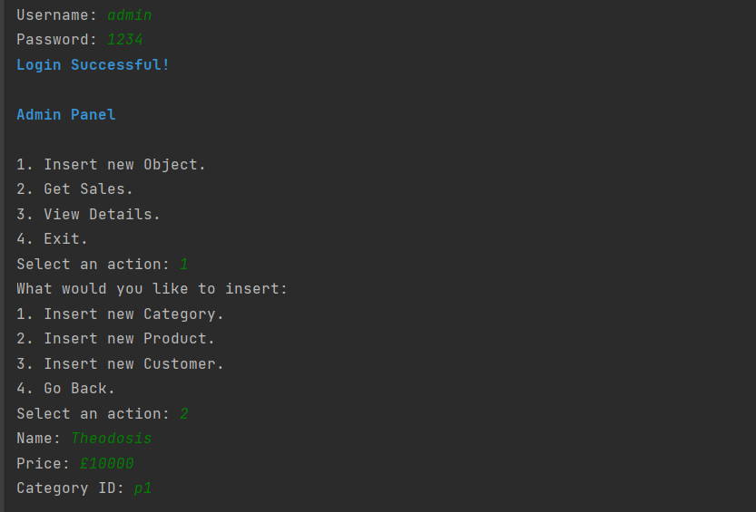
Outputs

Slide 9
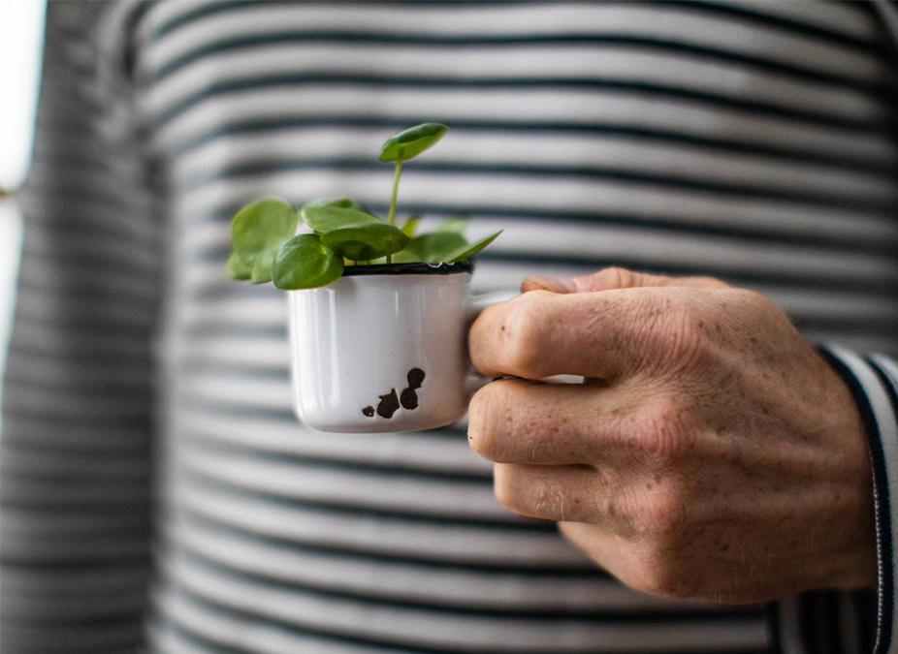
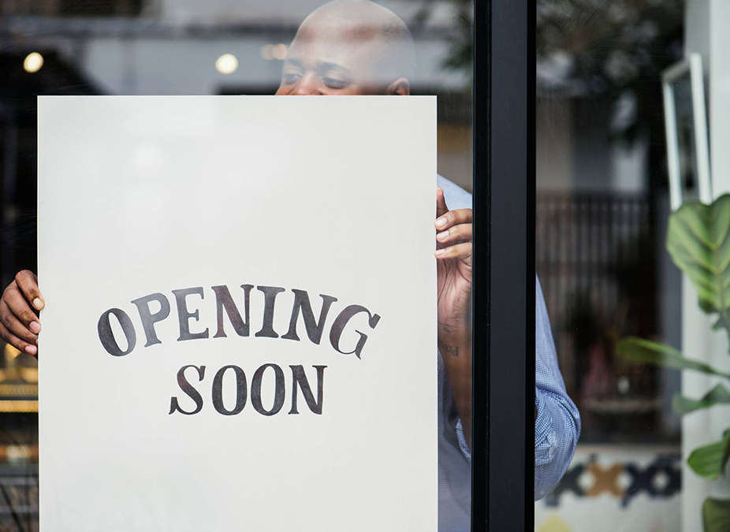
Thank you

